Slide 1
Software Engineering Unit-II
Prepared by:Neha Tripathi

Slide 2
Analysis Tools
Data Flow Diagrams(DFDs)
Data dictionary
Decision Tree
Decision Table

Slide 3
Data dictionary
Every DFD model of a system must be accompanied by a data dictionary.
A data dictionary lists all data items that appear in a DFD model.
The data items listed include all data flows and the contents of all data stores appearing on all the DFDs in a DFD model.
A data dictionary lists the purpose of all data items and the definition of all composite data items in terms of their component data items.
For example, a data dictionary entry may represent that the data grossPay consists of the components regularPay and overtimePay.
grossP ay = regularP ay + overtimePay
For the smallest units of data items, the data dictionary simply lists their name and their type. Composite data items are expressed in terms of the component data items using certain operators.

Slide 4
Importance/Benefits of Data Dictionary
A data dictionary provides a standard terminology for all relevant data for use by the developers working in a project. A consistent vocabulary for data items is very important, since in large projects different developers of the project have a tendency to use different terms to refer to the same data, which unnecessarily causes confusion.
The data dictionary helps the developers to determine the definition of different data structures in terms of their component elements while implementing the design.
The data dictionary helps to perform impact analysis. That is, it is possible to determine the effect of some data on various processing activities and vice versa. Such impact analysis is especially useful when one wants to check the impact of changing an input value type, or a bug in some functionality, etc.

Slide 5
Tool support
For large systems, the data dictionary can become extremely complex and voluminous. Even moderate-sized projects can have thousands of entries in the data dictionary. It becomes extremely difficult to maintain a voluminous dictionary manually.
Computer-aided software engineering (CASE) tools come handy to overcome this problem. Most CASE tools usually capture the data items appearing in a DFD as the DFD is drawn, and automatically generate the data dictionary.
As a result, the designers do not have to spend almost any effort in creating the data dictionary.
These CASE tools also support some query language facility to query about the definition and usage of data items.
For example, queries may be formulated to determine which data item affects which processes, or a process affects which data items, or the definition and usage of specific data items, etc.
Query handling is facilitated by storing the data dictionary in a relational database management system (RDBMS).

Slide 6
Data definition
Composite data items can be defined in terms of primitive data items using the following data definition operators.
+: denotes composition of two data items, e.g. a+b represents data a and b.
[,,]: represents selection, i.e. any one of the data items listed inside the square bracket can occur For example, [a,b] represents either a occurs o r b occurs.
(): the contents inside the bracket represent optional data which may or may not appear. a+(b) represents either a or a+b occurs.
{}: represents iterative data definition, e.g. {name}5 represents five name data. {name}* represents zero or more instances of name data.
=: represents equivalence, e.g. a=b+c means that a is a composite data item comprising of both b and c.
/* */: Anything appearing within /* and */ is considered as comment.

Slide 7
Decision Tree
A decision tree gives a graphic view of the processing logic involved in decision making and the corresponding actions taken.
It is a graphical technique representing decisions using a series of nodes and branches
Each node is a decision point - a choice has to be made
Each branch has a corresponding value to the decision choice
Subsequent action is the result

Slide 8
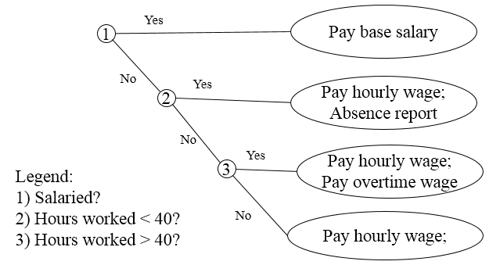
Example of Decision Tree

Slide 9
Decision Tables
A matrix representation of the logic of a decision
Specifies the possible conditions and the resulting actions
Based on a set of conditions, different actions will be performed
Best used for complicated decision logic
Consists of three parts:
Condition stubs
Lists condition relevant to decision
Action stubs
Actions that result from a given set of conditions
Rules
Specify which actions are to be followed for a given set of conditions

Slide 10
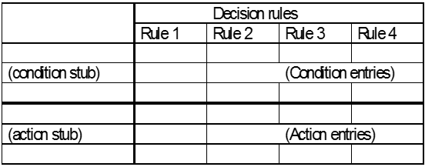
Structure of Decision Table

Slide 11
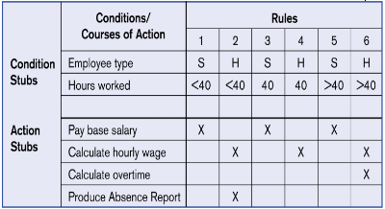
Decision table for payroll system example

Slide 12
Constructing Decision Table
Name the conditions and the values each condition can assume
Name all possible actions that can occur
List all possible rules
Define the actions for each rule
Simplify the decision table

Slide 13
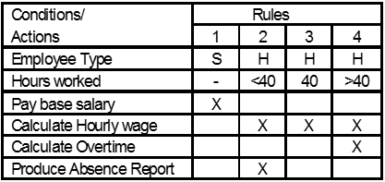
Simplified Decision Table

Slide 14
Decision table versus decision tree
Even though both decision tables and decision trees can be used to represent complex program logic, they can be distinguishable on the following three considerations:
Readability: Decision trees are easier to read and understand when the number of conditions are small. On the other hand, a decision table causes the analyst to look at every possible combination of conditions which he might otherwise omit.
Explicit representation of the order of decision making: In contrast to the decision trees, the order of decision making is abstracted out in decision tables. A situation where decision tree is more useful is when multilevel decision making is required. Decision trees can more intuitively represent multilevel decision making hierarchically, whereas decision tables can only represent a single decision to select the appropriate action for execution.
Representing complex decision logic: Decision trees become very complex to understand when the number of conditions and actions increase. It may even be difficult to draw the tree on a single page. When very large number of decisions are involved, the decision table representation may be preferred.

Slide 15
Thank You!

